Slide 1

Apache Flume & ZooKeeper
Parham Pishro
Dr. Nasiri
Notes:
By GAM98

Slide 2
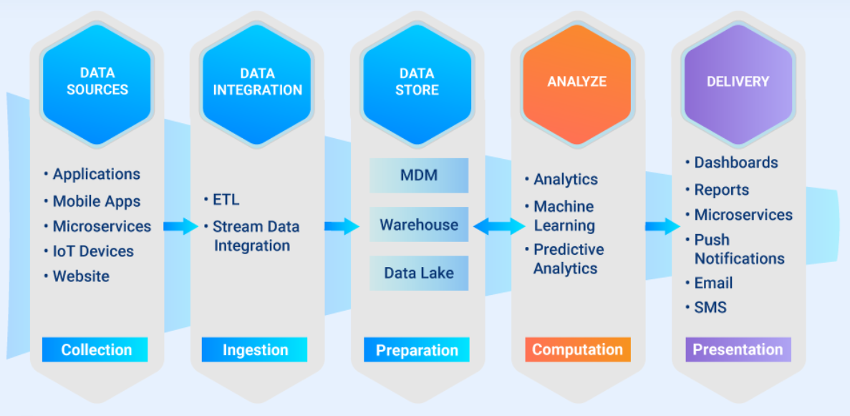


Pipeline of Big Data

Slide 3
Apache Flume
Jul 26, 2012
Jul 2, 2013
May 20, 2015
Oct 4, 2017
Aug 16, 2022
1.2.0
1.3.1
1.4.0
1.5.0.1
1.6.0
1.7.0
1.8.0
1.9.0
1.10.1
1.11.0
Jan 2, 2013
Jul 16, 2014
Oct 17, 2016
Jan 8, 2019
Oct 24, 2022

Slide 4
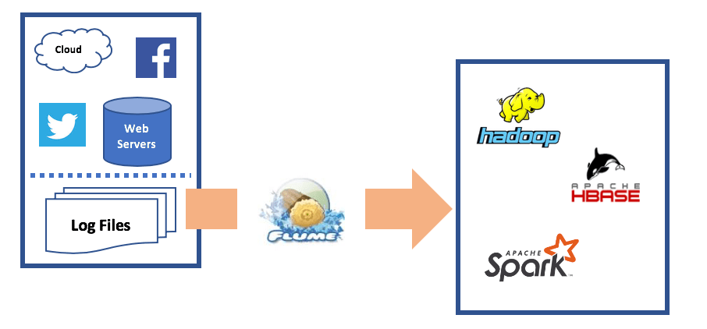

Introduction
to
Apache
Flume
flume.apache.org
Flume is a distributed, reliable, and available service for efficiently collecting, aggregating, and moving large amounts of streaming event data.

Slide 5
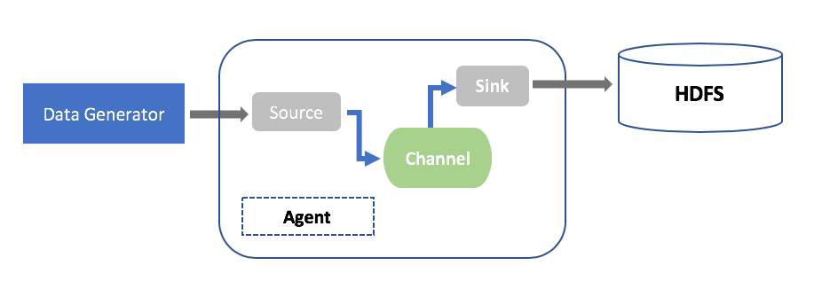
Architecture of Apache Flume
Move
Collect
Aggregate

Slide 6
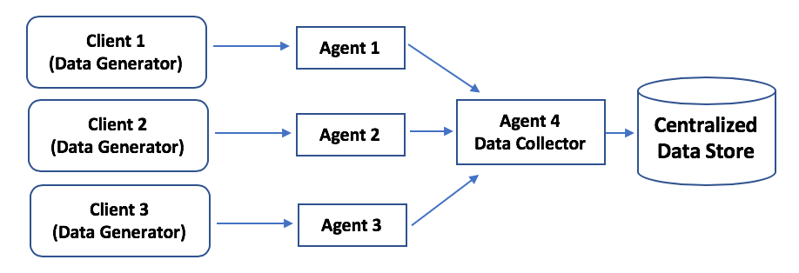
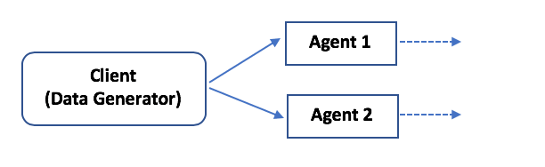
Two Types of Architecture

Slide 7
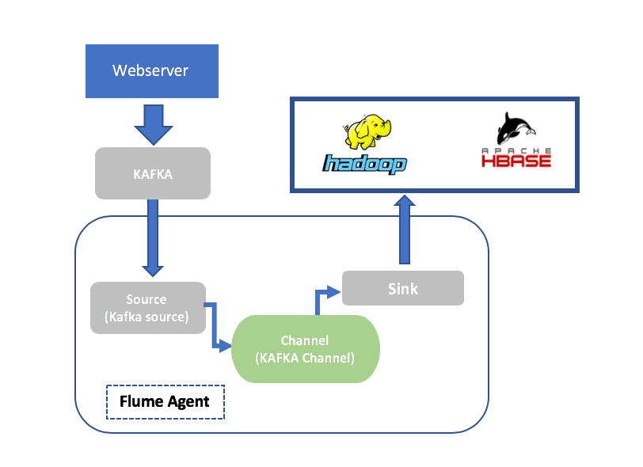
Example
Streaming Log Data to HDFS from Twitter
Twitter

Slide 8
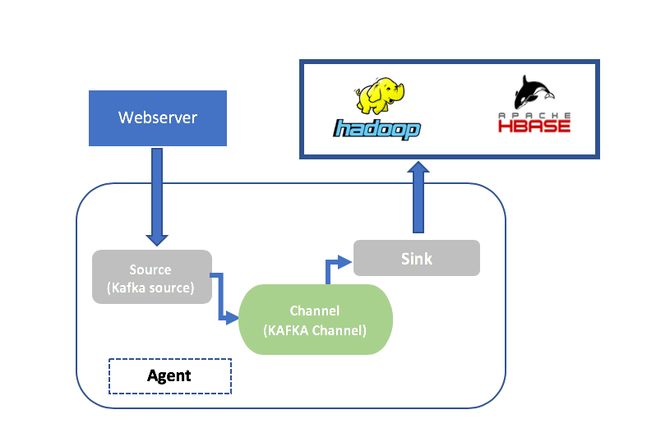
Example
Streaming Log Data from Kafka to HDFS
Kafka

Slide 9
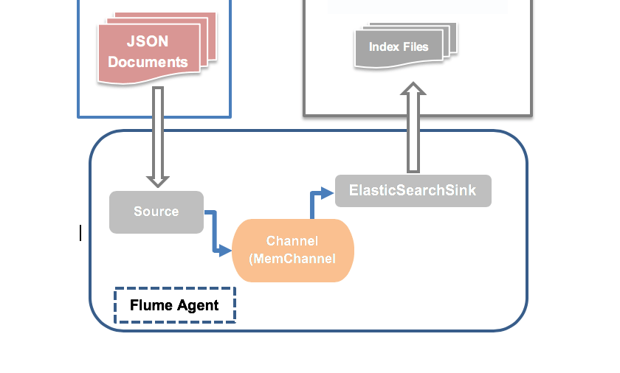
Example
Streaming Log Data to Elasticsearch

Slide 10
The Limitations of Apache Flume
- Complexity and difficulty of architecture to manage and maintain (From multiple sources to multiple destinations)
- Streaming is not 100% real-time
- Weakness to identify duplicate data

Slide 11
Apache ZooKeeper
Oct 27, 2008
Aug 2, 2012
Jan 15, 2021
May 12, 2022
3.0.0
3.1.2
3.3.6
3.4.14
3.5.9
3.6.3
3.7.1
3.8.1
Dec 14, 2009
Apr 2, 2019
Apr 13, 2021
Jan 30, 2023

Slide 12
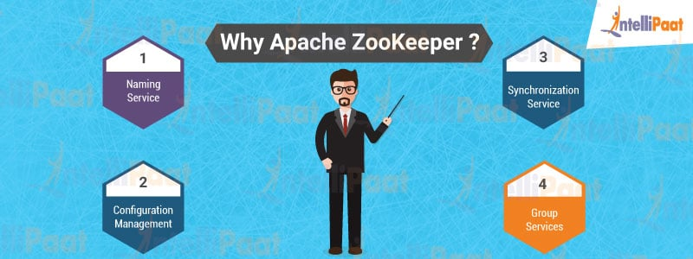
Why Do We Need Apache ZooKeeper?
Coordinating Different Services in Hadoop Ecosystem
(Systems Configuration with Data Synchronization)

Slide 13
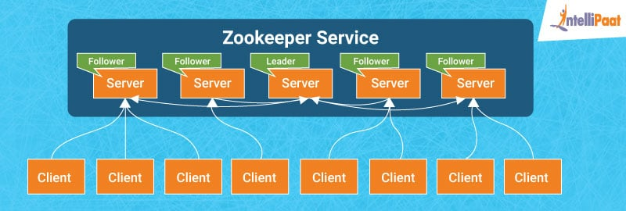
Architecture of Apache ZooKeeper
Server
Leader
Follower
Client

Slide 14


Working of Apache Zookeeper
ID

Slide 15
Working of Apache Zookeeper
ID

Slide 16
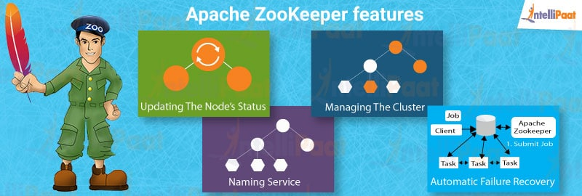
Features of Apache ZooKeeper

Slide 17
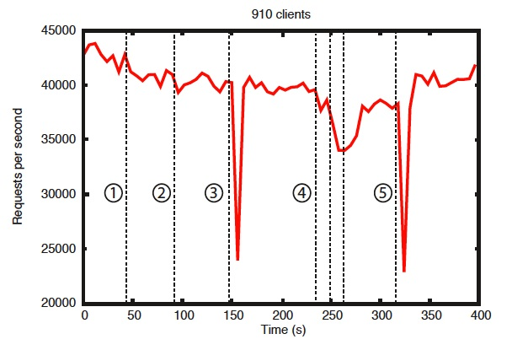
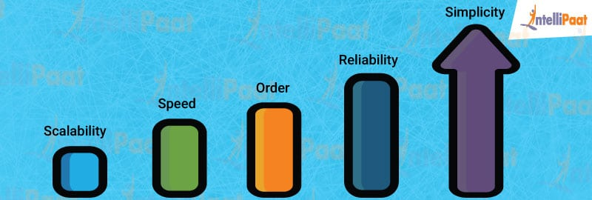
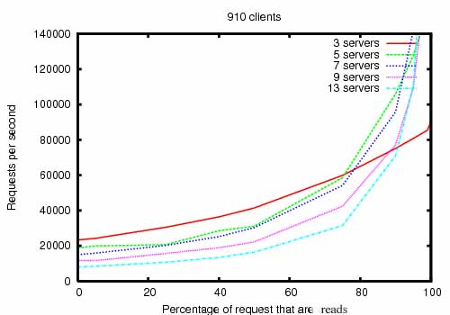

Benefits of Apache ZooKeeper
Simplicity: Coordination is done
Reliability: $\left[\frac{ n }{2}\right]+1$
Order: Stamping each update with a number
Speed: Runs with a ratio of 10:1 (when ‘reads’ are more common)
Scalability: Enhancement the performance by deploying more machines
Failure and recovery of a different follower
Failure and recovery of two followers
Failure and recovery of a follower
Failure and recovery of another leader
Failure and recovery of the leader

Slide 18
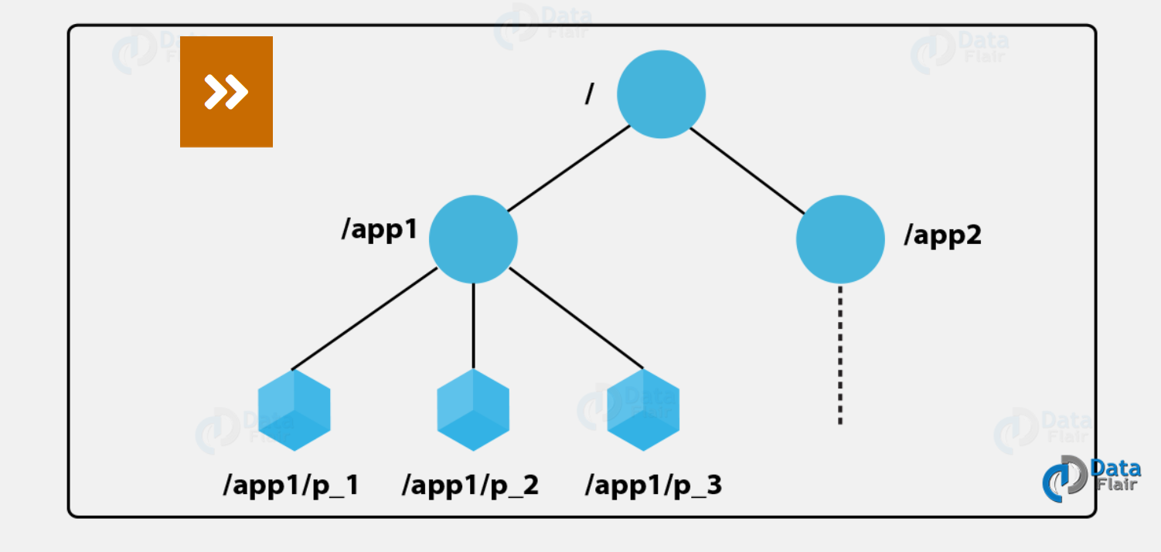

Data Model and The Hierarchical Namespace
Name = Sequence of path elements separated by a slash (/)
Every node is identified by a path.

Slide 19
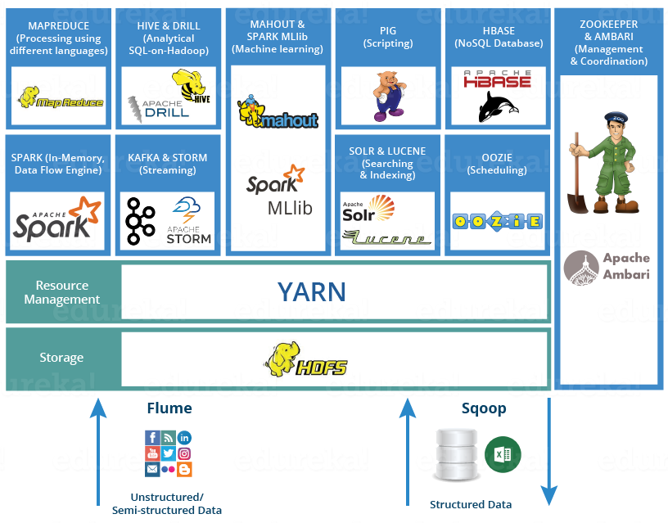

Slide 20
Thanks
for
Your
Attention

